Slide 1


Introduction to C# & .NET
A Developer’s Guide
Build Modern, Fast & Scalable Applications
Infosyntax

Slide 2

What's New & Agenda
What is C#?
What is.NET 10 (and why LTS matters)
Where you use it: Web, APIs, Desktop/Cloud
What’s new in C# 14 (6 practical wins)
Interview Q&A + tips
Career opportunities
Introduction to .NET 10
Infosyntax

Slide 3
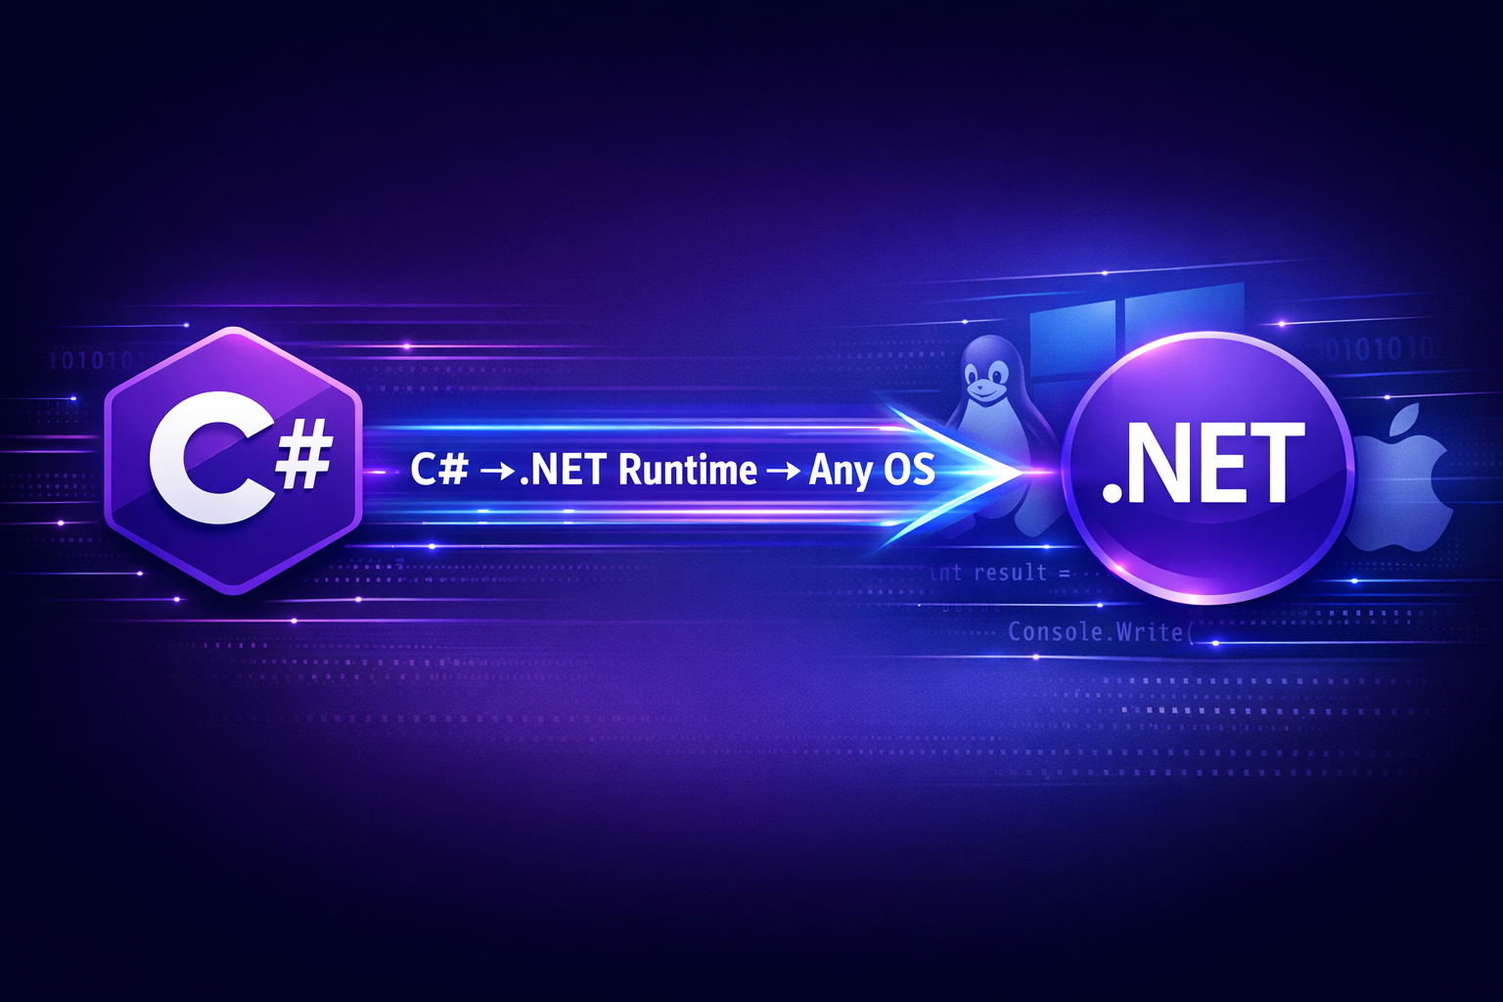
What is C#?
Modern, type-safe, object-oriented (and functional) language from Microsoft
Great tooling, huge ecosystem
Used for building applications
Introduction to .NET 10
Infosyntax

Slide 4

What is .NET?
Development platform/framework
Provides runtime & libraries
Supports multiple languages
Cross-platform (Windows, Linux, Mac)
Unified platform for apps & services (web, desktop, mobile, cloud, IoT)
LTS support till 2028
Big focus: performance, cloud-native, AI-assisted tooling, simpler start
.NET 10 is a Long-Term Support (LTS) release that ensures stability and longevity for applications. It is designed to be cross-platform, enabling developers to build applications on various operating systems. With its high performance, .NET 10 is optimized for speed and efficiency, making it a powerful tool for modern development.
Introduction to .NET 10
Infosyntax

Slide 5



Where You Use It
Web apps: ASP.NET Core, Blazor
APIs: Minimal APIs (lightweight & fast)
Desktop: .NET MAUI, Windows apps
Cloud: Containers, serverless apps
Introduction to .NET 10
Infosyntax

Slide 6
What’s New? – ASP.NET Core & Web
Modern Web Development
Minimal APIs with better diagnostics
Improved tooling for faster development
Enhanced Blazor for interactivity
Introduction to .NET 10
Infosyntax

Slide 7
C# 14 Feature 1: Extension Members
Group extensions into one block
Add methods + properties together
Cleaner and organized code
Introduction to .NET 10
Infosyntax

Slide 8
C# 14 Feature 2: field Keyword
Access auto-property backing field
No need for manual variables
Reduces boilerplate code
Introduction to .NET 10
Infosyntax

Slide 9
C# 14 Feature 3: Null-Conditional Assignment
Assign values safely using ?.
Avoid null reference errors
Cleaner defensive code
Introduction to .NET 10
Infosyntax

Slide 10
C# 14 Feature 4: Lambda Improvements
Use ref, out, in in lambdas
Better readability
Supports inferred types
Introduction to .NET 10
Infosyntax

Slide 11
C# 14 Feature 5 & 6
nameof(List<>) works without type arguments
Custom operators like += supported
Improves readability & control
Introduction to .NET 10
Infosyntax

Slide 12
What’s New? – C# 14
Feature | Benefit
Extension Members | Add methods to existing types
Null-Conditional Assignment | Assign values only when not null
nameof Unbound Generics | Reference generic types easily
Span Conversions | Implicit array/string to Span
Lambda Modifiers | Support ref / in / out
Introduction to .NET 10
Infosyntax

Slide 13



Why .NET 10 Matters – Market Demand
Career Growth
High demand for backend & cloud developers
Enterprise Stability
Large companies prefer LTS platforms
Cost Efficiency
High performance = lower cloud costs
Introduction to .NET 10
Infosyntax

Slide 14

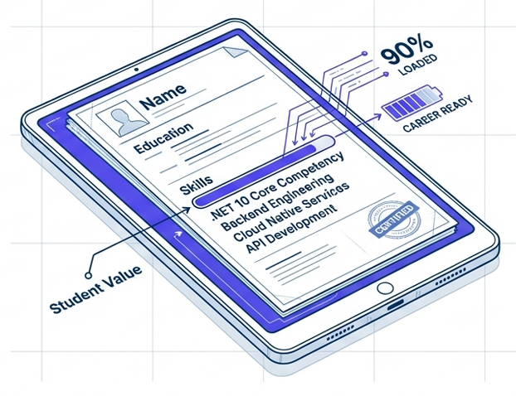
Why .NET 10 Matters – For Students
Build a Strong Foundation
Industry-standard skill for enterprises
& product companies
Roles Aligned
Backend Engineer, API Developer, Cloud Specialist
Portfolio Projects
REST APIs, dashboards, microservices
Introduction to .NET 10
Infosyntax

Slide 15

Why .NET 10 Matters – For Professionals
Risk Management
Safe for mission-critical systems
Cost Optimization
Reduces infrastructure overhead
Career Advancement
Path to Senior Backend Engineer, Cloud Architect
Introduction to .NET 10
Infosyntax

Slide 16
Interview Questions & Tips
C# vs .NET?
Key features of C# 14?
What is CLR?
What is Minimal API?
Why .NET 10 LTS?
Introduction to .NET 10
Infosyntax

Slide 17
Summary
C# = language
.NET 10 = platform (LTS)
Used in Web, API, Desktop, Cloud
C# 14 simplifies coding
Faster setup with single-file execution
Introduction to .NET 10
Infosyntax

Slide 18
Thanks for Watching!
Like, Subscribe & Hit the Bell Icon
Introduction to .NET 10
Infosyntax

